Slide 1
Diabetes
Isaac Miller, Payton Simon

Slide 2
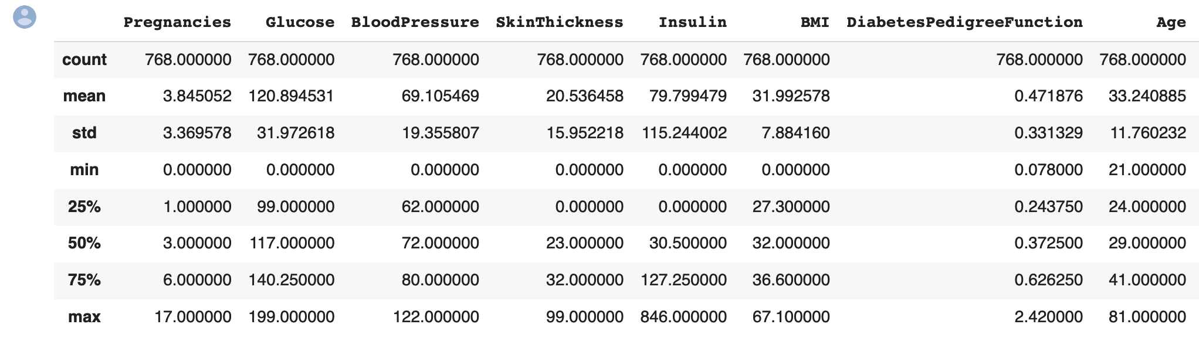
What is the dataset?
This dataset includes the following information on patients from the Pima Indian heritage (subgroup of Native Americans) who are female and older than 21: Pregnancies, Glucose, Blood Pressure, Skin Thickness, Insulin, BMI, Diabetes Pedigree Function, Age, and their Outcome.
We hope to find any correlation between any of the variables of pregnancy, glucose, blood pressure, skin thickness, insulin, BMI, Diabetes Pedigree Function, and age and whether they are likely to have diabetes
We hope to find a way to accurately predict the outcome of a test for Diabetes based on several factors.

Slide 3
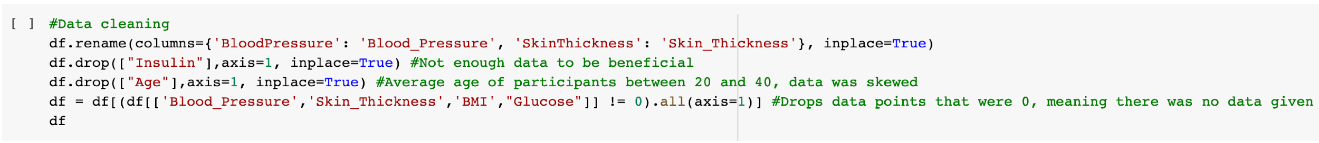
Cleaning and Preparing the dataset
Data was pre-made and obtained from Kaggle.
We removed the column “insulin” due to the overall lack of data representation within the column.
We removed the “Age” column because the data collected did not accurately give an balanced distribution of patients based on age. A majority of the participants were between the ages of twenty to forty

Slide 4
Cleaning and Preparing the dataset
At first, we were going to remove the Diabetes Pedigree Function because neither of us understood what it was. After some research, we determined that the pedigrees function is the probability of one’s likelihood to develop diabetes when looking at their family history.
Renamed columns ‘BloodPressure’ and ‘SkinThickness’ to ‘Blood_Pressure’ and ‘Skin_Thickness’

Slide 5
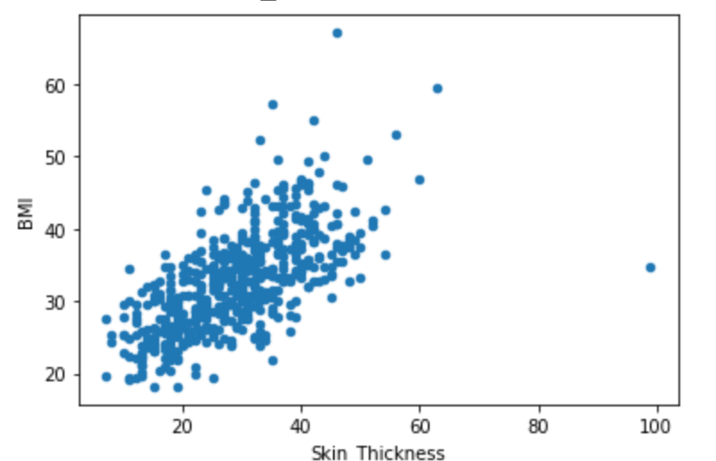
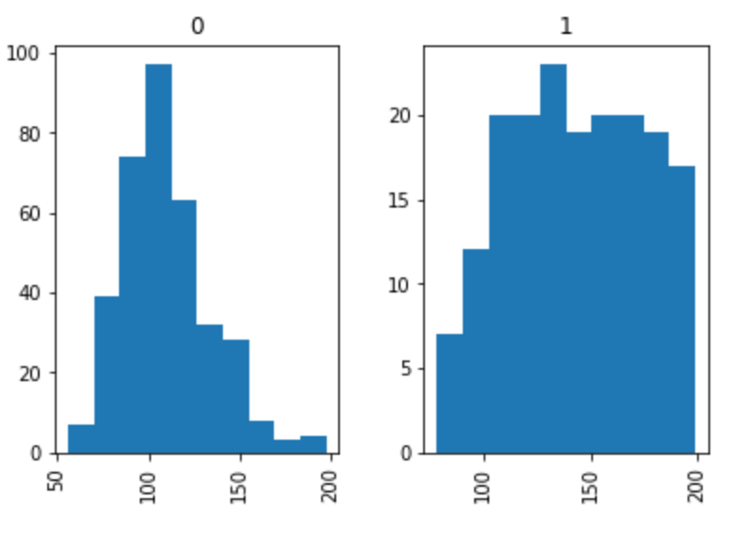
Exploring the Data
Correlations:
As Skin Thickness in the patient increases, so does the patient’s BMI
Participants glucose levels who had diabetes varied drastically between 100 and 200
participants who did not have diabetes on average had glucose levels between 80 and 125
Those with diabetes
Diabetic patients were more likely to have more pregnancies, a higher BMI, and a higher value of Diabetes Pedigree function (next slide)

Slide 6
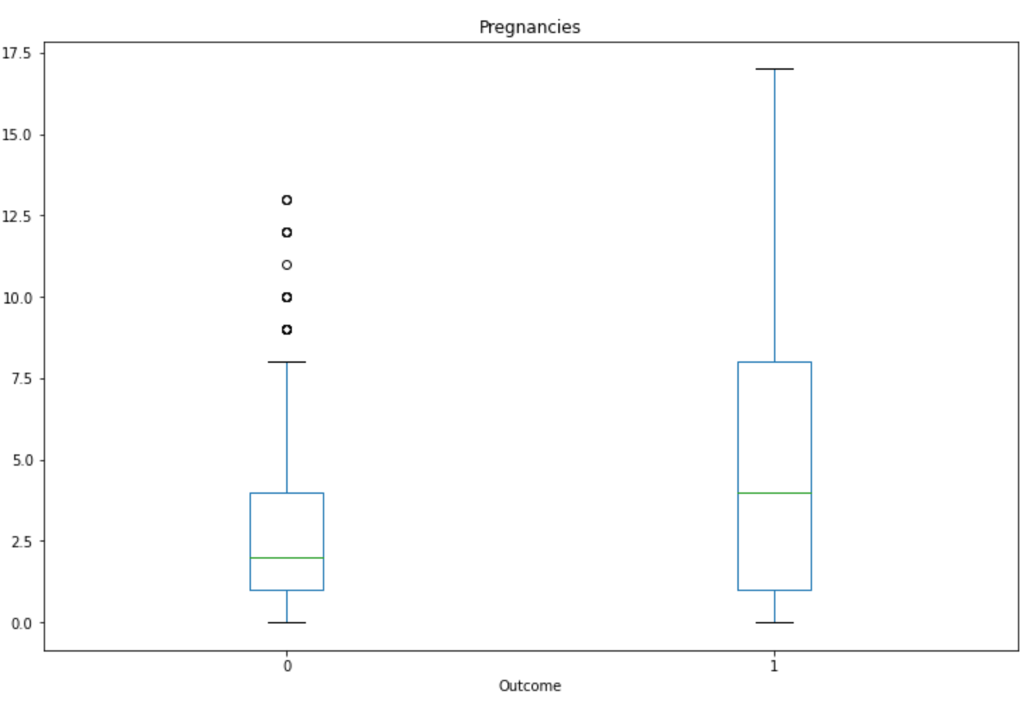
Exploring the Data: Pregnancies by outcome
non-diabetic =0 diabetic=1

Slide 7
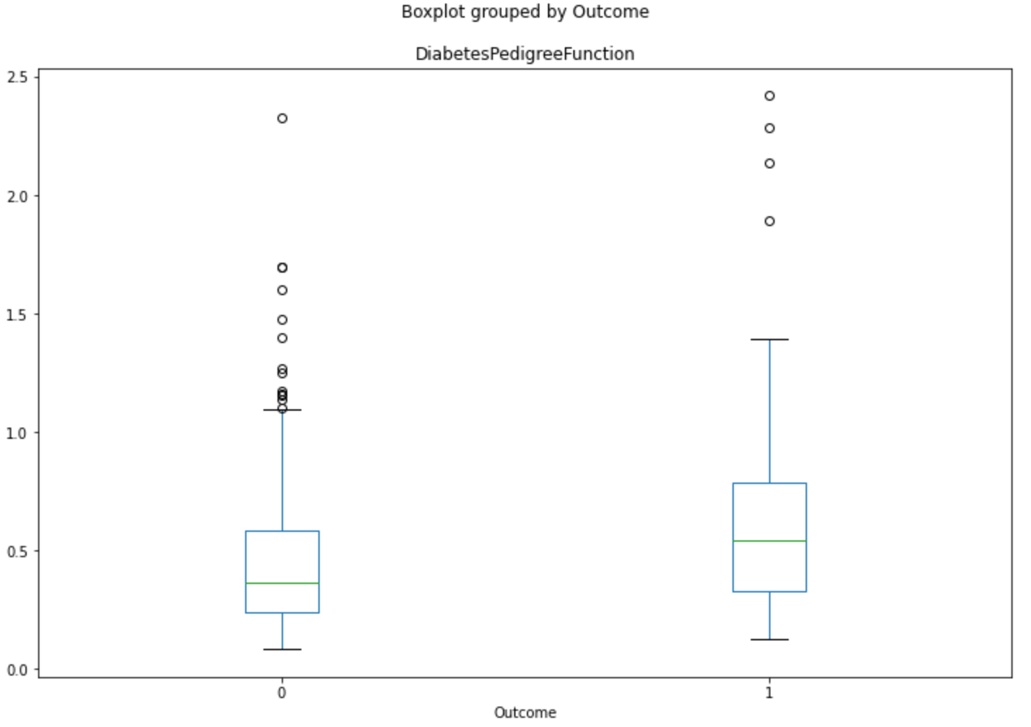
Exploring the Data: DP Function by outcome
non-diabetic =0 diabetic=1

Slide 8
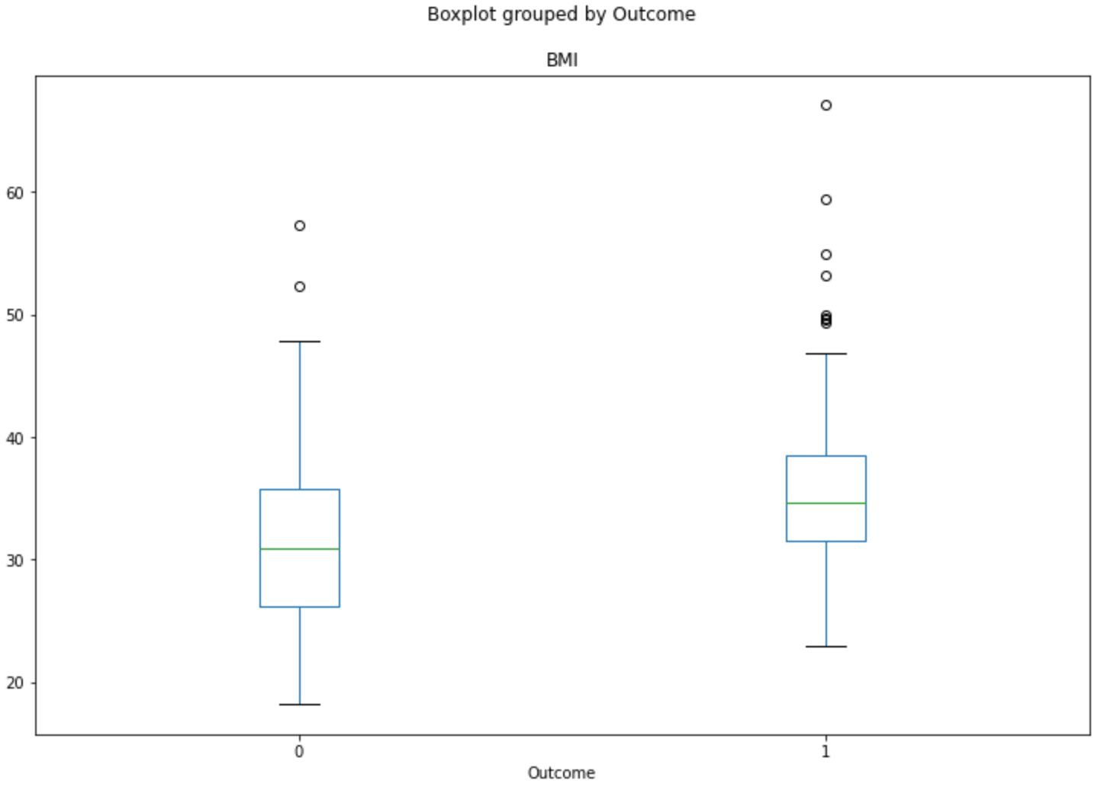
Exploring the Data: BMI by outcome
non-diabetic =0 diabetic=1

Slide 9
Problems and Improvements
Problems
A majority of the patients are between the ages of 21 and 30, leaving the data skewed
There is an insufficient amount of information included about the women’s insulin levels
The data is taken from a very specific group of women. This data is only an accurate representation of this specific group. Have a sample size include wider range of Native American tribes
Improvements
Ensure that the age group is consistent: either from 18-30 or 40+
Ensure the age groups are equally distributed in amount
Include more information on individual’s insulin levels

Slide 10
Hypothesis
Based on the given variables and our findings while analyzing the dataset, we believe that there is a correlation between the pima indian women’s body index numbers to being diabetic or not.

Slide 11
Selecting our Machine Learning Models
When determining our model, we needed to work with a learning method that would take into consideration parameters we wanted to input and the data set we have.
From that we narrowed our choices down to Logistical Regression, K Neighbors, and Decision Tree.

Slide 12
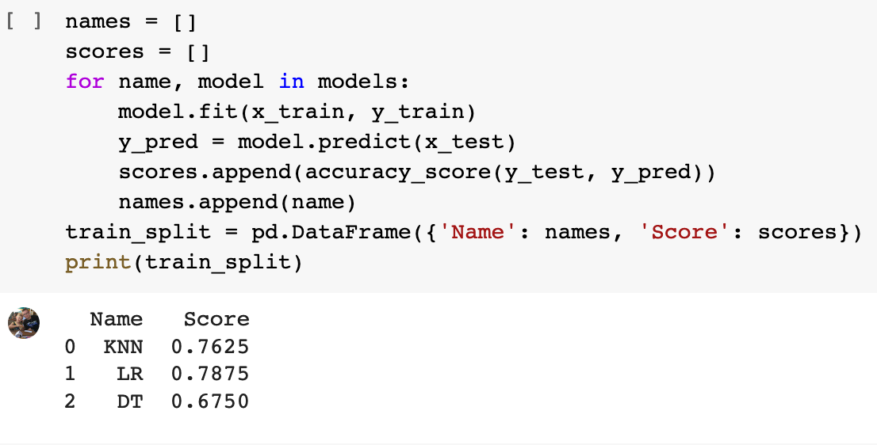
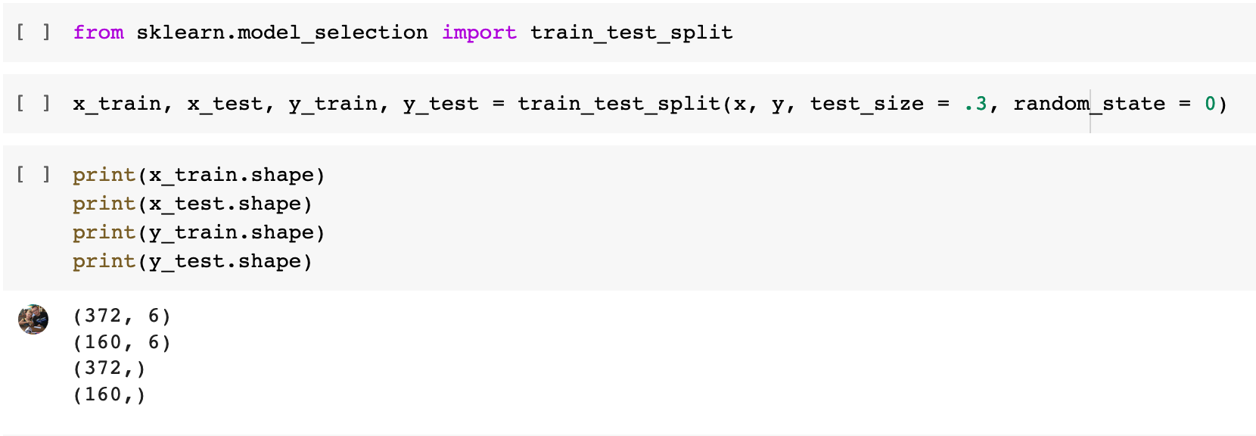
Accuracy measurement, train/test split,
Our accuracy measurement for our logistical regression machine learning model was 78.75%
We went with a 70% training group and a 30% test group.
From a pool size of 532, we trained with 372 and tested 160

Slide 13
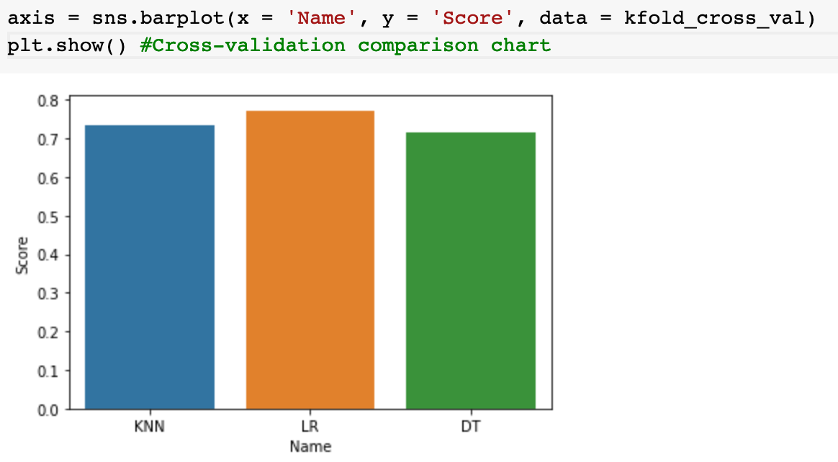
Cross-validation
By using Kfold, we were able to compare the logistical regression accuracy with the other two machine learning models.
Once again, The logistical regression model had the highest score

Slide 14
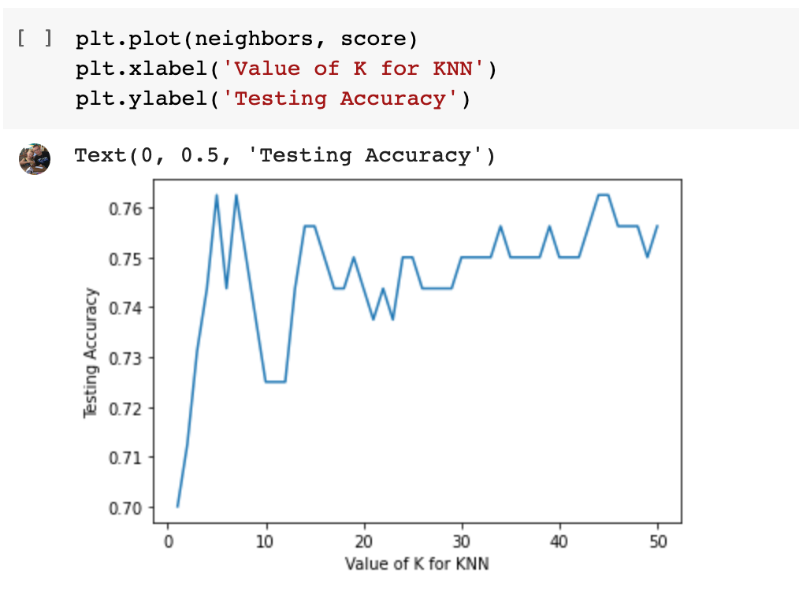
Model evaluations, comparing with other Machine Learning algorithms
We tested K Neighbors 50 times. The accuracy of the prediction never reached over 80%
We compared the accuracy and cross-validation for all three machine learning models on our dataset.
Logistic regression had a higher accuracy and cross-validation score when compared to the k Neighbors and Decision Tree

Slide 15
Conclusion
Based off of our findings from comparing accuracy and cross-validation scores, we believe the best machine learning model is the logistical regression model.
From the logistical machine learning model, we believe there is a somewhat strong correlation between the pima indian tribe women’s body indexes and the likelihood as to whether or not they were diagnosed as diabetic
The best

